Slide 1
developmentalCounseling interactions
Module 6
Notes:
Module 6: Instructions for Trainers
The main topic of this module
This module covers the use of motivational interviewing in developmental counseling interactions.
What you want people to be able to do at the end
Distinguish forward- from backward-focused questions
Explain the importance of emphasizing autonomy in advice giving
Demonstrate the use of “SMART” goals in planning
Demonstrate in a brief interview the use of the CET
Needed material
Distribute copies of the PowerPoint slides
Distribute copies of the CET Soldier and Leader forms
Training tips
Make sure you read and are familiar with the material.
Present material slowly. Give people time to absorb and ask questions.
Model what you are training. When you introduce a skill, give an example of that skill, or better yet demonstrate that skill.
Use primarily open questions to elicit people’s ideas about the material. This eliciting process is an important part of discovery.
Make sure to reflect back what people are saying. This repetition is important in learning.
Ideally, the trainer should talk less than half the time. If you are the only one talking, people are probably not learning very much.
TLaL is a skills-based training. It’s very important that people are seeing you demonstrate the skills, have the opportunity to practice those skills, and are able to debrief on the experience.

Slide 2
https://www.youtube.com/watch?v=2byzvkF7J60
Notes:
This 2-minute video, called the “10 Meter Tower,” shows a series of people climbing to the top of a 10 meter diving board that have to choose whether to jump or climb down. It shows people’s ambivalece when placed in a vulnerable situation.
Play the video.

Slide 3
Different Conversation Styles
Directing
Guiding
Following
Soldier
Leader
Soldier
Leader
Soldier
Leader
Notes:
Our goal is to achieve a “guided” style that results in a collaborative conversation.
In this style, the leader serves as a mentor who helps the Soldier think through the best way to address an issue.

Slide 4
Stick with “Forward Focused” Questions
Avoid | Try
Why did you do that? | How can you fix this?
Why did you forget to submit the form? | What’s your plan to make sure the form gets submitted next time?
Why are you late? | How will you make sure you’re here on time tomorrow?
Notes:
This chart shows different ways of asking questions.
Ask: What’s the difference between the statements on the left and statements on the right? Answers might include:
The ones on the left sound more negative, are about the past, are about the person (rather than the situation), etc.
The ones on the right are about the situation (rather than the person), sound like they are looking for solutions, etc.
Reflect what people are saying. (You could also ask people to scan the questions on the “Very Useful Question sheet.)
Give the following backwards questions and ask people to come up with a forward focused alternative for each:
What mistakes did you make? (vs. What did you learn?)
What things could get in your way? (vs. How will you address the issues that come up?)
Why can’t you do that? (vs. How could you do that?)

Slide 5
Ask Questions Like These
What would be the first step?
What would you need to do to make that happen?
How can I help you? What do you need?
What would that look like? Where would you start? What would happen next?
What are some things that might get in your way? How would you deal with that?
If you’re at a 2 now in your progress, what would it take to get you to a 3?
Notes:
Here are examples of more forward focused questions that are part of a guided style.
Ask: What are some other open questions that ask about what someone could do, will do, or things that will work for them? Answers might include:
How would you do that?
What steps would you take?
How are you going to reach that goal?
Reflect what people are saying.

Slide 6
“Elicit Provide Elicit”
“What do you know about…?”
“That’s right. I’ve also seen that…”
“So what’s your plan?”
“What are you thinking you’ll do about…?”
“That’s right. Another thing you might consider is…”
“So what’s your first step?”
Notes:
Elicit-Provide-Elicit is a way to provide information in a guided style. It works like this:
Ask the person what they already know about something, or what questions they have (Elicit).
Give a small amount of information (Provide), building on what the Soldier has said.
Ask what the person would like to do with the information or how they would implement it (Elicit).
Demonstrate the process:
Ask one person to name one of the behaviors they have talked about during this training (diet, fitness, sleep, finances).
Ask the person (Elicit): What do you already know about the ways people change that behavior?
Give a small amount of information, advice, personal experience, etc. (Provide)
Ask the person a forward-focused question about that behavior (Elicit): What would be the best way for you to start to work on that behavior?
Ask: Why is it important to allow the person to talk at the beginning and end of this brief conversation? Answers might include:
It can show off people’s expertise (what they know).
It helps people to own their actions.
Change talk at the end can make it more likely that they will follow through.
Reflect what people are saying.

Slide 7
Give Advice Without Telling Someone What to Do
Ask for permission.
Would it be okay if I gave you some information about…
If you don’t mind, let me give you a suggestion here…
Preface advice with permission to disagree.
This may or may not apply to you, but…
Give a menu of options.
There are a couple things you could do here…
Emphasize personal choice.
…but again, you’ll have to decide what will work best for you.
Notes:
Here are examples of ways to provide information in a guided style.
The goal is to provide the best instruction, while still giving a person ownership over their actions. If we try to solve people’s problems ourselves, they are not able to learn how to problem solve on their own.
When leaders do provide advice, certain things make it more likely that a Soldier will act on that information.
Read each of the categories and examples:
Ask for permission
Preface with permission to disagree
Give 2-3 options
Emphasize personal choice
Ask: Why would these strategies make it easier for people to take our advice? Answers might include:
It doesn’t sound as pushy
People have more choice if they have a couple options
People have to work through what is the best course of action for them
Reflect what people are saying.
Ask: Under what circumstances would you skip these, and go right to giving advice or instruction? Answers might include:
If there’s an emergency situation, or if the information is very simple or narrow
If people are already motivated (for instance in the planning or action stage of change)
Reflect what people are saying.

Slide 8
Setting “SMART” Goals
 | Key Question | Example
Specific | What specifically do you want to achieve? | I’d like to get more experience in air defense.
Measurable | How will you know if you’ve reached your goal? | When I leave the Army, I’d like to get my degree in aviation or aerospace engineering.
Attainable | What resources are needed? | I would need to apply to Air Defense Artillery School.
Realistic | Is the goal reasonable? | I have a good head for numbers. Aerospace is a big industry where I live.
Time-Bound | When will each of the steps be completed without kicking the can down the road? | In the next week, I’d like to do some research on what training programs are available.
Notes:
People who talk more specifically about a goal are more likely to achieve it.
Goals should be Specific, Measurable, Attainable, Realistic, and Time bound (sometimes called “SMART” planning).
Read each of the Key Questions and Examples.
If a Soldier has a large goal, it may help to break the goal into smaller, short-term steps that will increase the chance of success.
Ask: Why would talking about a goal this way make it more likely that someone would follow through? Answers might include:
They’re thinking through the steps
They’re talking about the benefit to them personally
They’re committing to doing something.
Reflect what people are saying.

Slide 9
Soldier Says: “I know I need to improve my PT score.”
What questions could you ask to make this goal…
Specific
Measurable
Attainable
Realistic
Time-bound
Notes:
Ask: If a Soldier has this general goal (to improve PT), what are some questions you could ask to make it “SMART”? Answers might include:
Specific: What part of PT would you like to improve?
Measurable: By how much? How are you going to measure that?
Attainable: What resources would you need to accomplish that?
Realistic: Is that a reasonable goal given the amount and timeline?
Time-bound: By when?
Reflect what people are saying.

Slide 10
Soldier Says: “I’ve got to lose some weight. Maybe five pounds.”
What questions could you ask to make this goal…
Specific
Measurable
Attainable
Realistic
Time-bound
Notes:
Ask: If a Soldier has this general goal (lose 5 pounds), what are some questions you could ask to make it “SMART”? Answers might include:
Specific: Are you more focused on the diet or exercise part?
Measurable: How would you track that (minutes of exercise, calories, etc.)?
Attainable: What kinds of things would help you achieve your goal?
Realistic: Is that a reasonable goal given the amount and timeline?
Time-bound: What’s your timeframe?
Reflect what people are saying.

Slide 11
Example: Effective de-escalation and planning
https://youtu.be/e6f5UqYtkkc
Notes:
In the next slide, the NCO uses uses OARS to de-escalate a conflict and move the conversation towards a solution.
Ask trainees to notice what kinds of skills the NCO is using to demonstrate good listening and move the conversation towards a solution.

Slide 12
How did the NCO demonstrate good listening and move the conversation towards A Solution?

Slide 13
Counseling enhancement tool (CET)
Promote professional development during counseling
two-way, interactive conversation
Share observations, expectations, develop collaborative plan
Leaders and Soldiers complete parallel forms
Notes:
We’ve been focusing on skills you can use during any kind of conversation, and now we want to talk about how to do developmental counseling using a new tool—the Counseling Enhancement Tool (CET).
The CET involves both a form as well as a meeting to review performance and goals.
The CET form has two parts: a Soldier Form and a Leader Form.
The Soldier Form is completed by the Soldier before the meeting. It helps the Soldier think through his/her own performance and goals.
The Leader form is completed partly before and partly during the meeting. It contains both the leader’s observations as well as the Soldiers ideas and goals.
The CET meeting is a collaborative conversation where the two parties are working together to come up with goals (and complete the Leader form).
Ask: How is this model different than other types of counseling you’ve been involved with? Answers might include:
It’s more collaborative; gets input from both parties; uses two forms
Reflect what people are saying.

Slide 14
CET
Tactical and Technical Proficiency
Exhibits Effort
Exhibits Personal Discipline
Contributes to the Team
Communicates Effectively
Exhibits Fitness, Military Bearing and Appearance
Manages Personal Matters
Notes:
The CET covers seven topic areas, gleaned from doctrine and research, relevant to all junior enlisted Soldiers.
Read each of the areas:
Tactical and Technical Proficiency
Communicates Effectively
Exhibits Effort
Exhibits Personal Discipline
Contributes to the Team
Exhibits Fitness, Military Bearing, and Appearance
Manages Personal Matters
Ask: Where would you address some of the behaviors we’ve been discussing so far? What area would these fall into?
Soldier looks worn out in the morning? (could be Personal Discipline; Bearing and Appearance)
Soldier has mentioned trouble at home? (could be Manages Personal Matters)
Soldier seems isolated, and is not connecting with others? (could be Contributes to the Team)
Others have commented about the Soldier’s appearance and hygiene? (could be Bearing and Appearance)
Reflect what people are saying

Slide 15
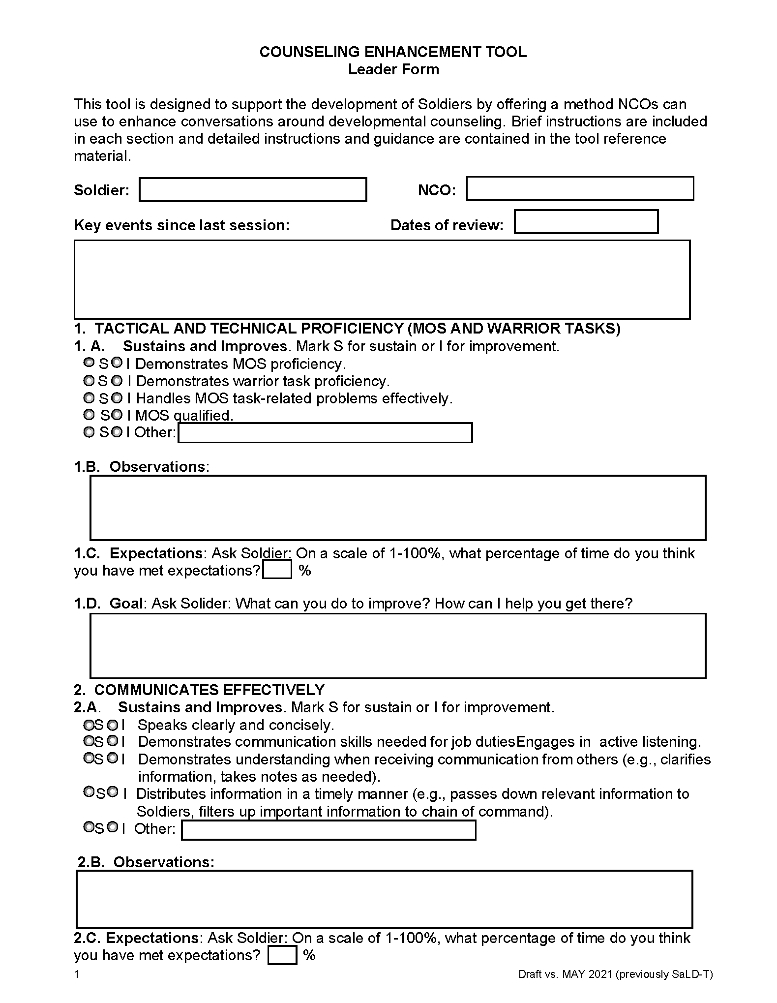
Before the meeting:
Ask Soldier to complete Soldier version
Give Sustain/Improve rating for each area (Section A)
Make notes about Soldier’s behavior, including areas of strength and opportunities for growth (Section B)
Notes:
Ask people to flip through the CET Soldier and Leader forms.
Explain what happens prior to meeting with a Soldier:
Provide the Soldier with a copy of the Soldier version. The purpose is to help them think about the areas you will cover during counseling.
Fill out Sections A and B of each question. Give a rating in each area and write at least a few observations to support your rating.
Your observations should include areas of strength, as well as opportunities for growth. Observations should be as specific as possible, including the frequency of the behavior, the impact it has on others, and its connection to Soldier and team performance.

Slide 16
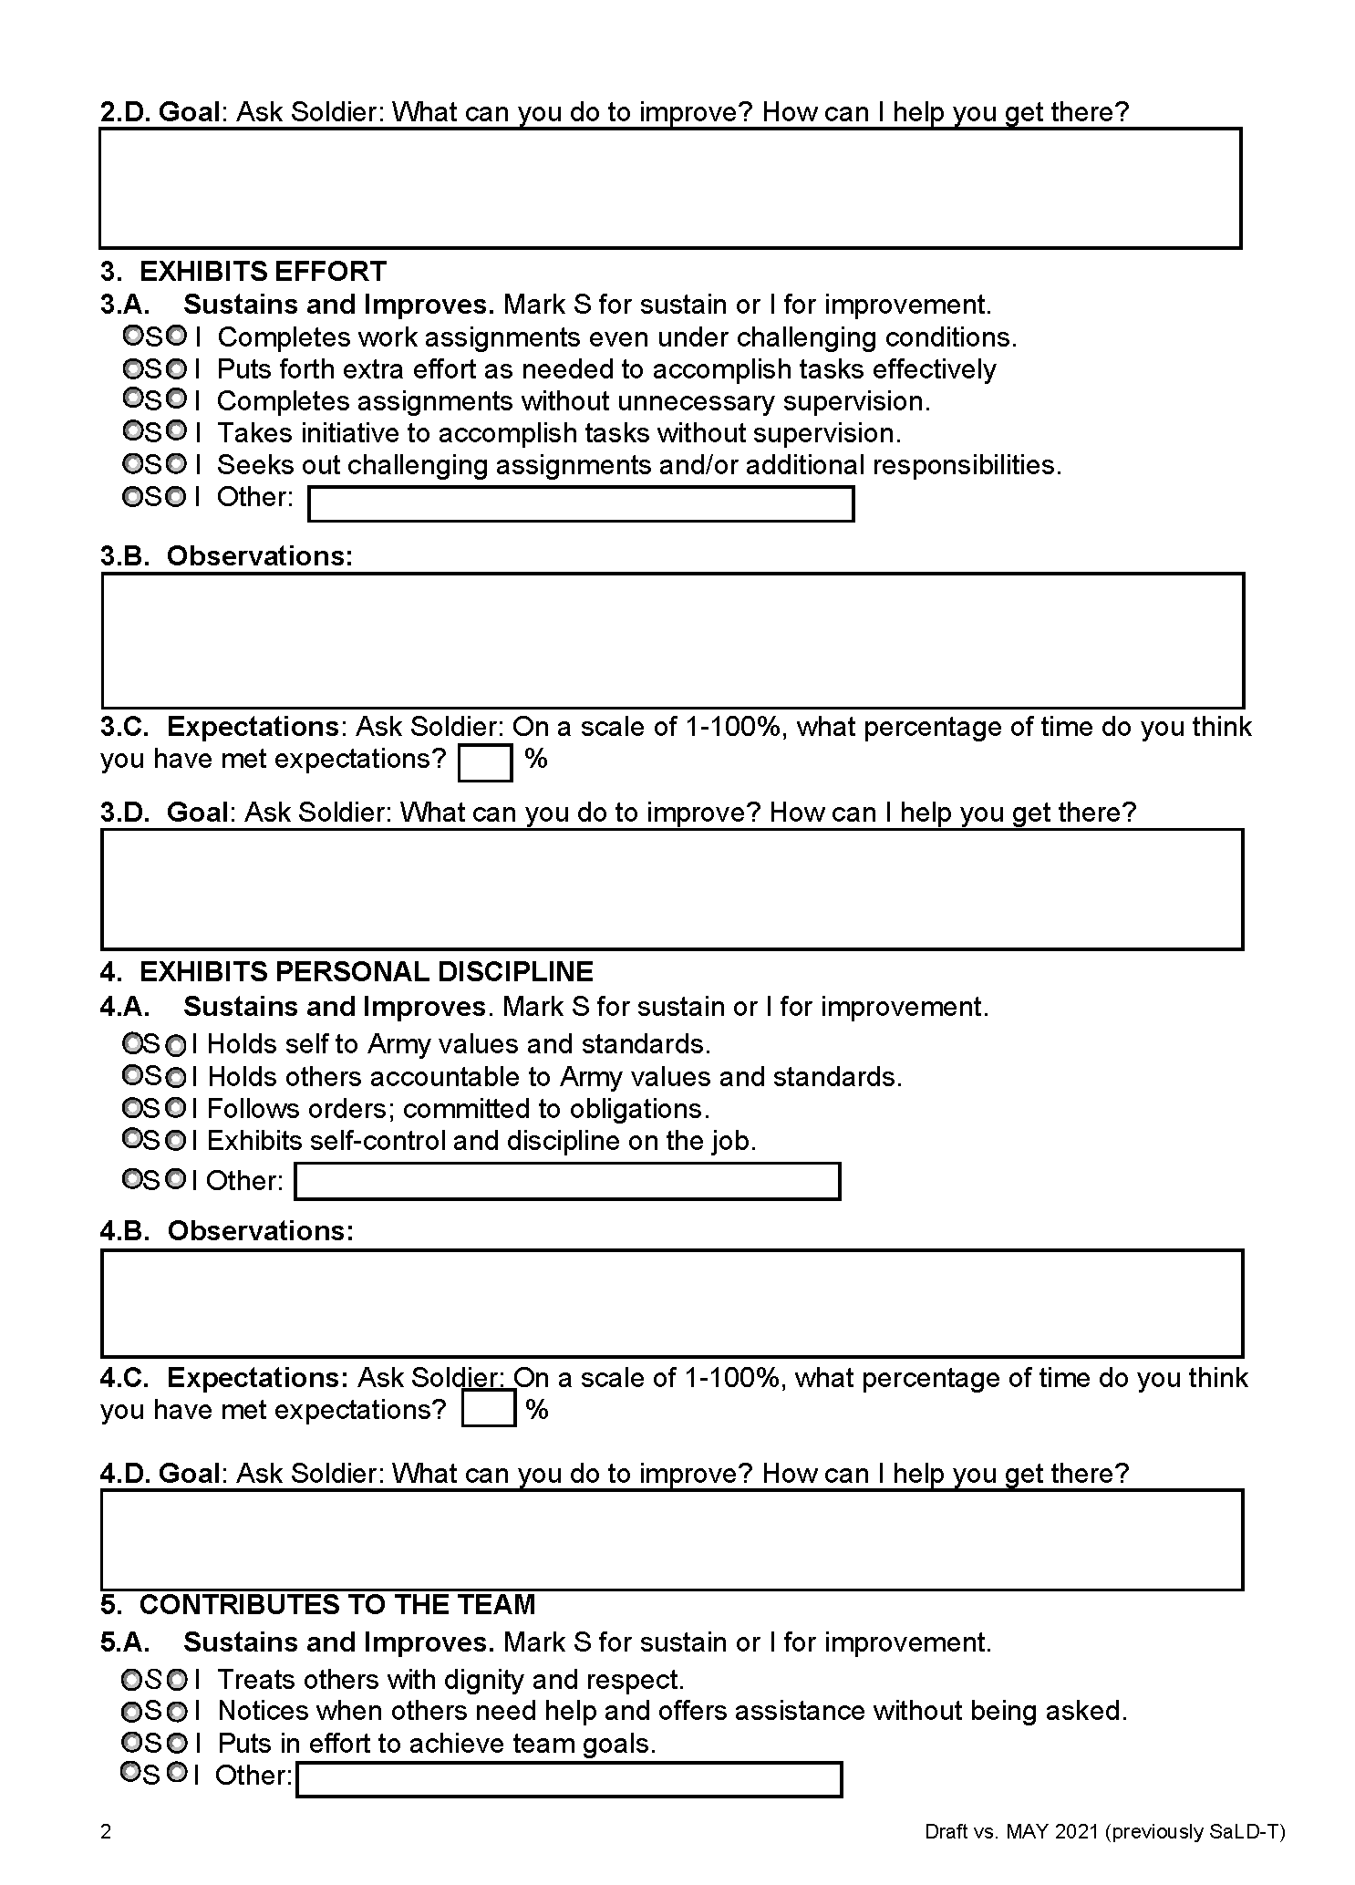
During the meeting:
Use questions to elicit Soldier’s input on % met in each area (Section C). Reflect and summarize
Share observations and elicit Soldier input, with a focus on areas of strength
Use questions and reflections to negotiate SMART goals, barriers and resources (Question 8)
Summarize the interaction
Notes:
Explain what happens during the meeting.
Make sure you schedule sufficient time with the Soldier to cover the form.
Cover the areas one at a time, asking the Soldier what score they would give themselves in each area (Section C):
Why did you give yourself that score?
What things are you doing well in that area (e.g., why not a lower score)?
What would it take to improve that score by just 5 or 10%
Negotiate a few goals including both the Soldier’s ideas and your own input (Section D).
Set 2-3 SMART goals that operationalize the changes the Soldier wants to make (Question 8). For instance, the Solider might identify 1-2 goals, while you might identify 1-2.

Slide 17
Example:
How often do you believe you’ve met this expectation? [Open Question]
So you think… [Reflection]. From my perspective I might add… [Information]
What are some areas for improvement from your perspective? What would it take to improve by 5 or 10%? [Open Question]
That’s a good idea to… [Affirm]
There’s a couple other options you might consider, for instance… [Provide Menu] Which one of those might work? [Open Question]
Let me summarize what we’ve talked about so far… [Summary]
Notes:
Here’s an example of a section focused on expectations in one area.
Ask: What skills do you see here that we have been focusing on? What’s the leader’s goal by using open questions, affirmations and reflections? Answers might include:
Trying to get the Soldier’s idea; break down the steps; remind the Soldier about what was discussed
Reflect what people are saying.

Slide 18
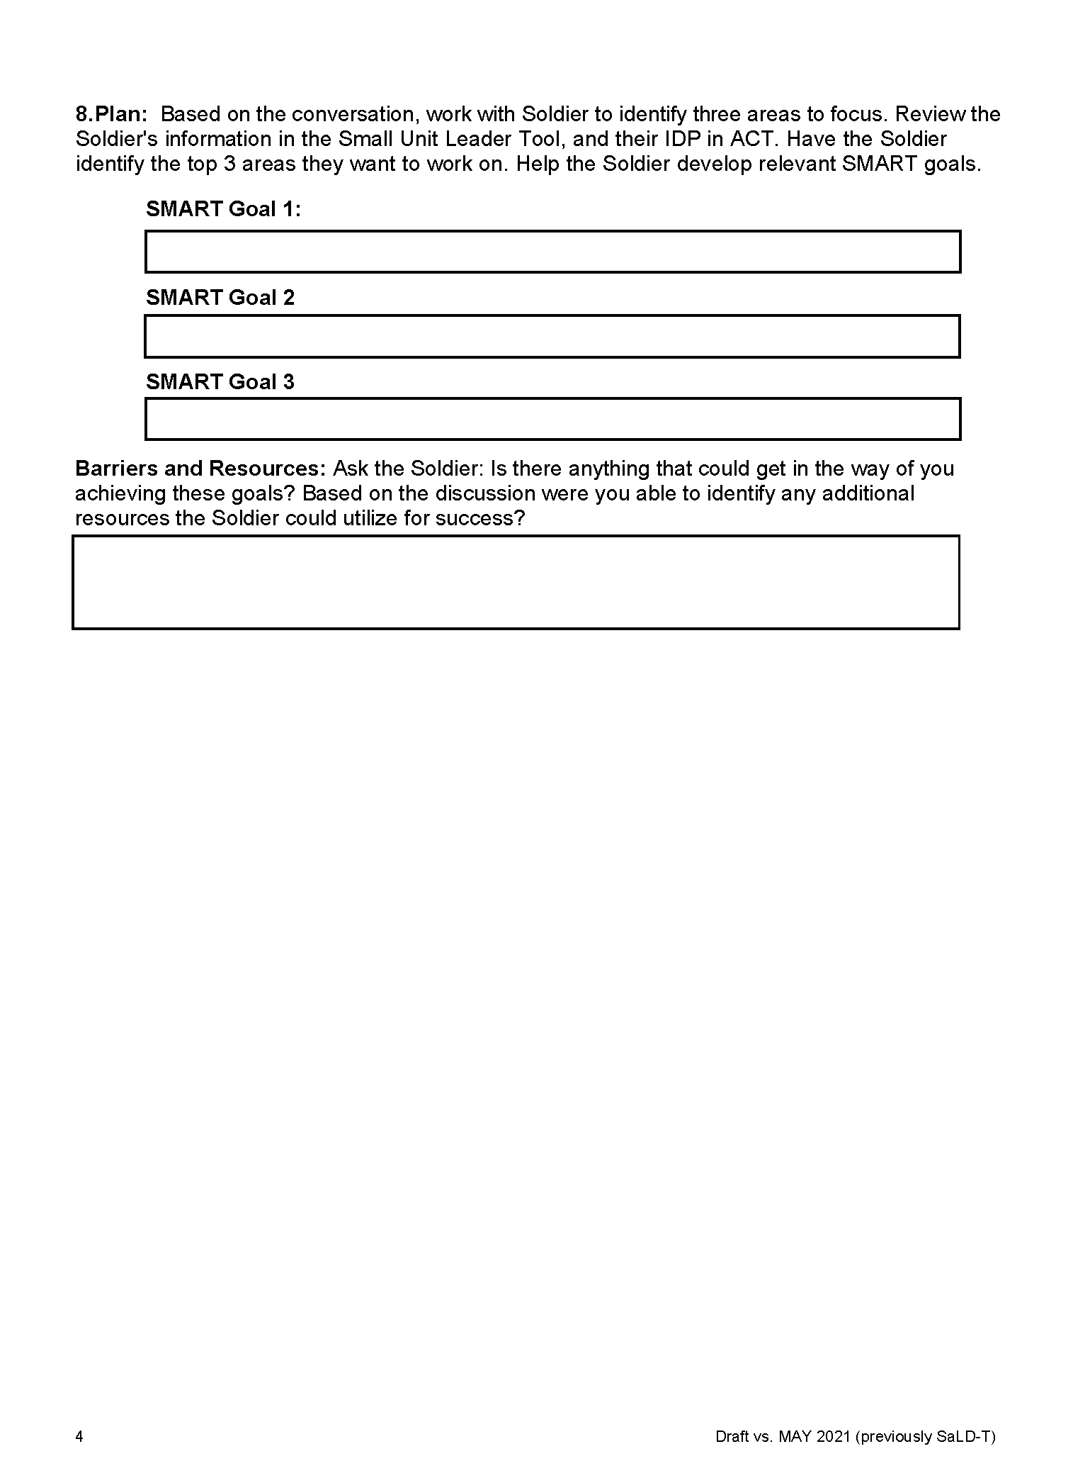
Example:
One of the areas you said you wanted to improve was…One thing you wanted to do was… [Reflection]
What’s one goal you would like to set in that area? What’s the timeframe? How can I assist? [Open Question]
OK, so you want to…and you think that… [Reflection]
In addition, I’d like to challenge you to… [Information] What would it take to improve in that area? [Open Question]
So you think you can… [Reflection]
What are some things that might get in the way? How could you troubleshoot? [Open Question]
Notes:
Here’s an example of a section focused on expectations in one area.
Ask: What skills do you see here that we have been talking about? What’s the leader’s goal by using open questions, affirmations and reflections? Answers might include:
Think about areas of improvement; break down goals; troubleshoot areas of potential difficulty
Reflect what people are saying.
Ask people to use the CET Leader Form, break into pairs, and role play the meeting.
Remind people they can use the “Very Useful Questions” handout if they like.
If the group is smaller than 10-12 people:
Ask people to do a sequential role play with the Soldier A scenario (next slide). One person will play the leader and the other person will play Soldier A.
Each pair will role play one section of the CET meeting while the other pairs watch.
Complete all the sections of the CET. (Remind people that it may run long in the demonstration, but when it is used in practice, each area might not be covered in the same depth.)
If the group is larger than 10-12 people:
Break the room in half. Larger groups will have two sequential role plays.
Ask people to do a sequential role play with the Soldier A scenario (next slide). One person will play the leader and the other person will play Soldier A.
Each pair will role play one section of the CET meeting while the other pairs watch.
Complete all the sections of the CET. (Remind people that it may run long in the demonstration, but when it is used in practice, each area might not be covered in the same depth.)
When finished, ask people to switch roles. Repeat the exercise with the Soldier B scenario.

Slide 19
Soldier A
Returning from deployment; reputation for being smart, a leader
When in garrison, history of poor performance and heavy drinking
Previous arrest, license suspension for DWI
At times, was a poor influence on other squad members
Married with two young children
On time to formation this week, but looks worn out
How would you conduct a counseling session with the CET?

Slide 20
Soldier B
Newly enlisted
Fair work ethic, but lacks many life skills
History of poor financial decisions
Puts little effort into training, spends time eating junk food and playing video games
Seems easily influenced. You’re worried other soldiers may be a bad influence on him
How would you conduct a counseling session with the CET?

Slide 21
Counseling debrief
What change talk did you notice? What(s) goal did you set?
What kind of follow-up would you want to have with this Soldier?
Notes:
Ask: What change talk did you notice? What goal(s) did you set? Answers will vary.
Ask: What kind of follow-up would you want to have with this Soldier? What would the next conversation look like? Answers will vary.
Reflect what people are saying.

Slide 22
Example: Effective listening and planning after a discouraging event
https://youtu.be/I-gda2p5mZI
Notes:
In the next slide, the NCO uses is using OARS to demonstrate good listening after a Soldier has had a discouraging event (failed a PT test).
Ask trainees to notice what kinds skills the NCO is using to facilitate the conversation.

Slide 23
How did the NCO use effective listening to demonstrate understanding and move towards solutions?

Slide 24
Module 6 Debrief
Write down one thing you learned in this module that stands out
Notes:
Give people 2 minutes to write down something they learned in this module. (They may want to flip through the material.)
Ask: What’s one thing you learned in this module that stands out?
Reflect what people are saying.

